Slide 1
Foreclosures and Affordability
Housing Markets Impacted by the Recession in 2009
Christopher Kalfas, Richard Varos, Thomas McCann

Slide 2
Scope of Project
Modes: Graphs/Charts/JSON/CSV
Methods: MySQL/Javascript/Leaflet/D3/Bootstrap/Chart.js/JQuery
Foreclosure Bubble Map
Foreclousre % Chart.Js line graph
Affordability matrix 2009 & 2018
Median Income and Price per square foot Mouseover
Questions
1. Which metropolitan areas see the highest foreclosure rates?
2. How have these rates changed over time?
3. Based off current affordability, which areas may be impacted going forward
Datasets/Links
https://www.zillow.com/research/data/
https://www.zillow.com/howto/api/GetUpdatedPropertyDetails.htm
https://www.realtytrac.com/statsandtrends/foreclosuretrends/
http://files.zillowstatic.com/research/public/State.zip

Slide 3
Recession Fallout
Subprime mortgage crisis
Housing bubble
Bank and lending mistrust
Increased loan limits

Slide 4
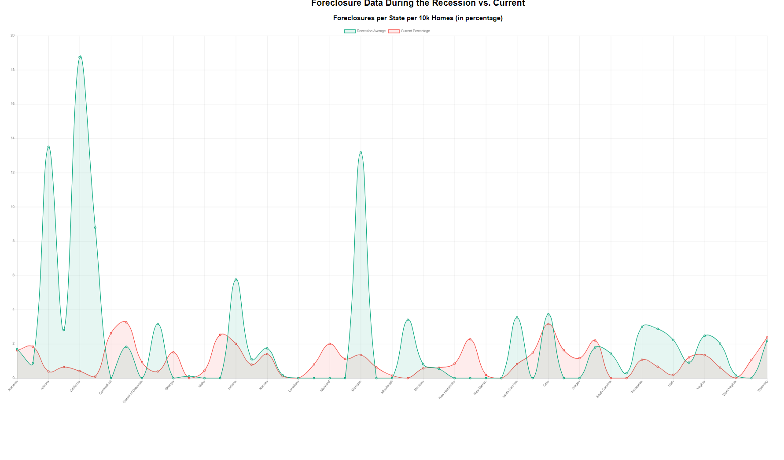

Slide 5
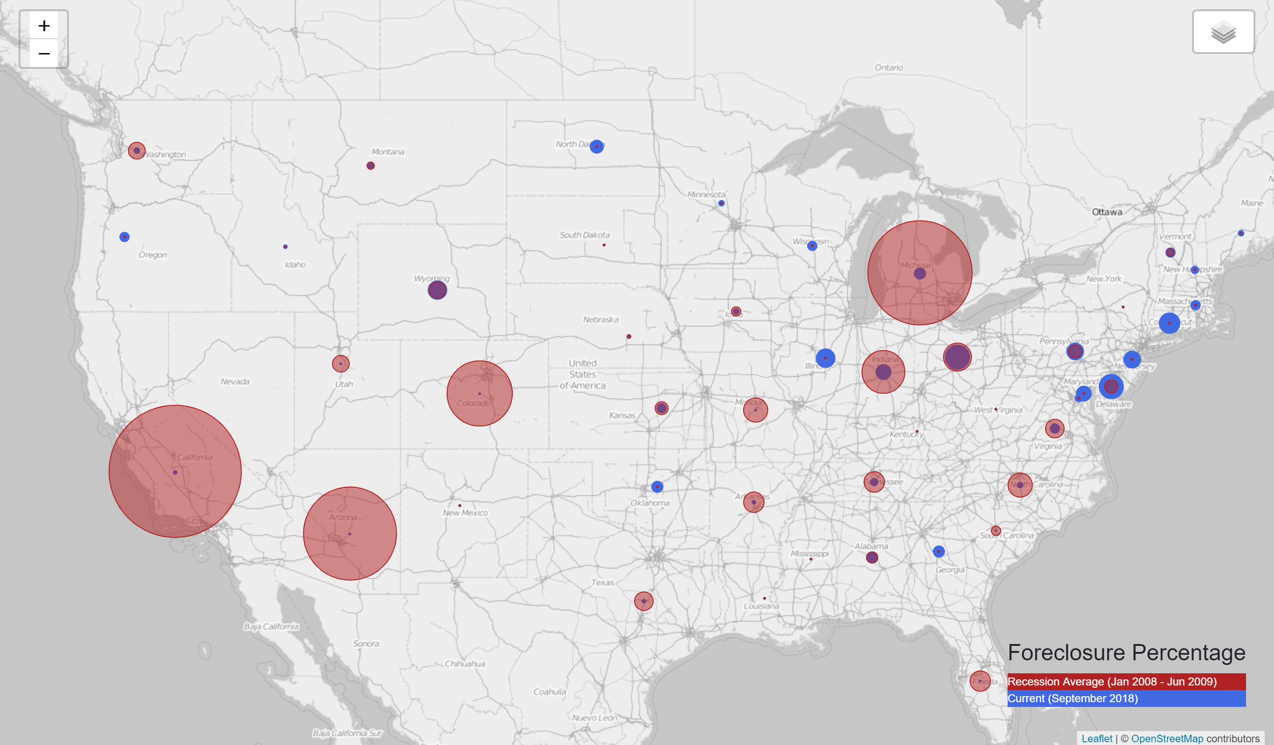
Visualizing the Impact

Slide 6
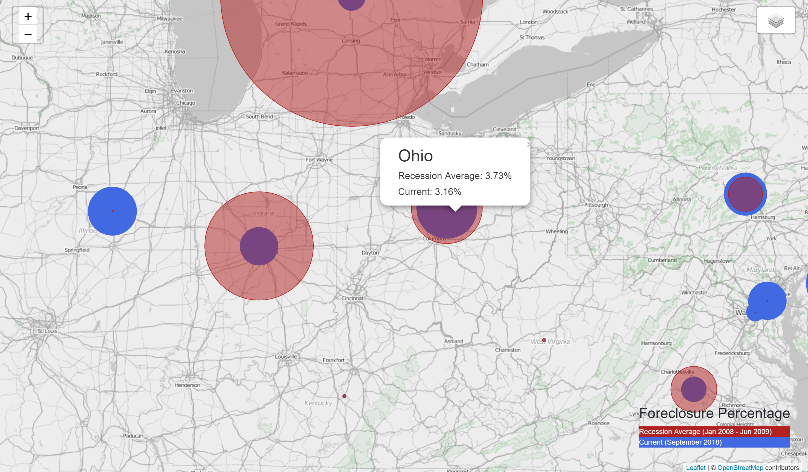

Slide 7
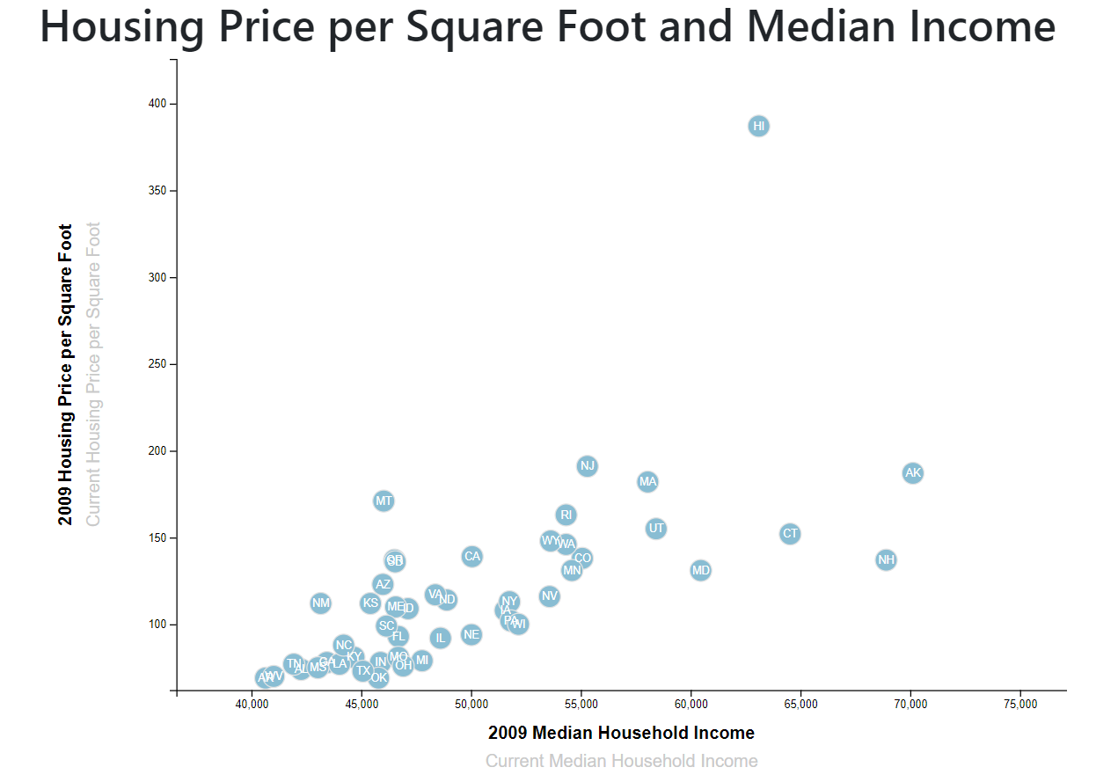
2009 Affordability

Slide 8
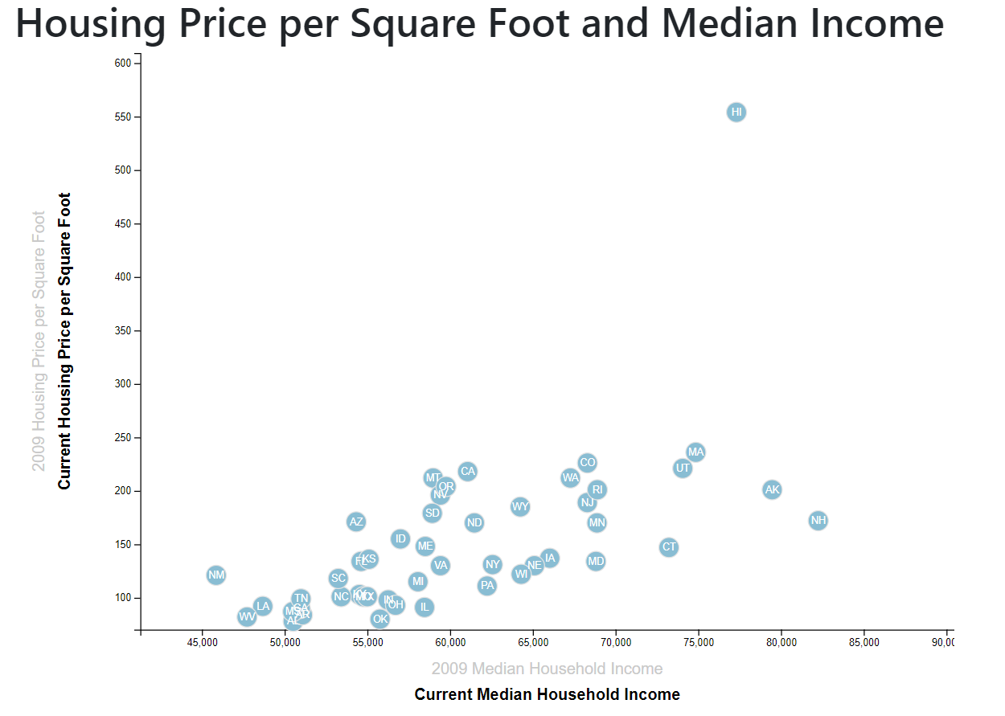
2018 Affordability

Slide 9
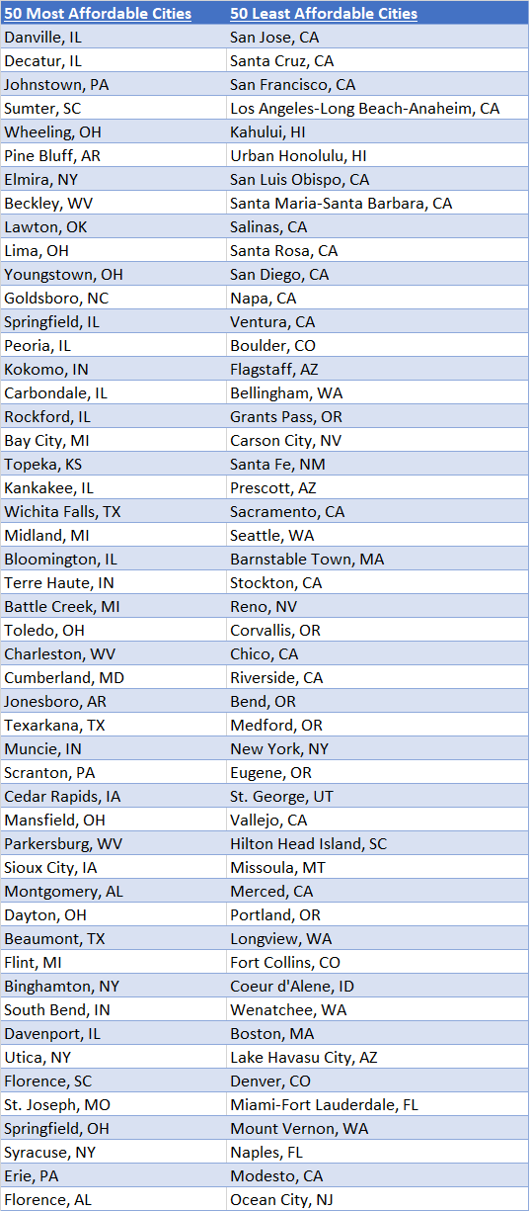
Affordable Cities

Slide 10
Price per Square Foot Relative to Income: 2009 and Today
By no surprise, at the depth of the recession in 2009 Housing prices were at 20 year lows. Long story short, banks lent money beyond the means of borrowers. This strongly influenced the housing bubble burst. Foreclosure numbers accelerated in 2008 and 2009. Individual wealth was compromised, economic markets were depressed, small businesses folded and surviving companies were strapped for cash. This was a perfect storm of economic failure.
The bright side to this was that housing prices normalized. Those who had not yet entered the market for a house could now find value given approval for a loan or capital to pay cash. However, there were a number of geographic areas hit hard by this recession. Mortgage lending regulations were tightened. Fewer people qualified for loans. With stricter lending guidelines and declining wealth, fewer households were affording mortgages causing this sharp decrease in housing prices.
Over the past 10 years, wages have risen and interest rates have been near all time lows. The result has been an economic boom. Housing prices, in most areas, are back to the highs that existed just before the bubble burst. Is this healthy and sustainable growth or are we approaching another detrimental event? From the list of Affordability provided by Zillow, we see that the San Francisco Bay Area cities, Southern California coastal towns and a couple metropolitan areas in Hawaii are facing housing problems. Larger Midwestern cities have been a hotbed for real estate investors seeking value in the market in recent years. Smaller cities in this area are still seeing very affordable pricing. It seems people are not racing to pitch camp in the likes of Pine Bluff, Arkansas.

